Slide 1
Eigenvectors & Eigenvalues

Slide 2
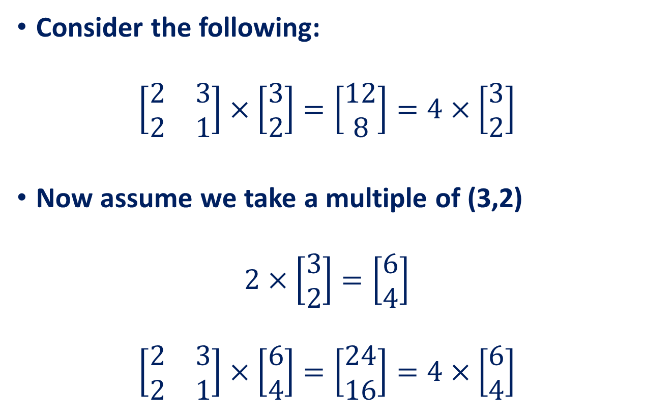
Transformation Matrices
Consider the following:
$$\left[\begin{matrix}2 & 3 \\ 2 & 1\end{matrix}\right]×\left[\begin{matrix}3 \\ 2\end{matrix}\right]=\left[\begin{matrix}12 \\ 8\end{matrix}\right]=4×\left[\begin{matrix}3 \\ 2\end{matrix}\right]$$
Now assume we take a multiple of (3,2)
$$2×\left[\begin{matrix}3 \\ 2\end{matrix}\right]=\left[\begin{matrix}6 \\ 4\end{matrix}\right]$$
$$\left[\begin{matrix}2 & 3 \\ 2 & 1\end{matrix}\right]×\left[\begin{matrix}6 \\ 4\end{matrix}\right]=\left[\begin{matrix}24 \\ 16\end{matrix}\right]=4×\left[\begin{matrix}6 \\ 4\end{matrix}\right]$$

Slide 3
Transformation Matrices
Scale vector (3,2) by a value 2 to get (6,4)
Multiply by the square transformation matrix
And we see that the result is still scaled by 4.
WHY?
A vector consists of both length and direction. Scaling a vector only changes its length and not its direction. This is an important observation in the transformation of matrices leading to formation of eigenvectors and eigenvalues. Irrespective of how much we scale (3,2) by, the solution (under the given transformation matrix) is always a multiple of 4.

Slide 4
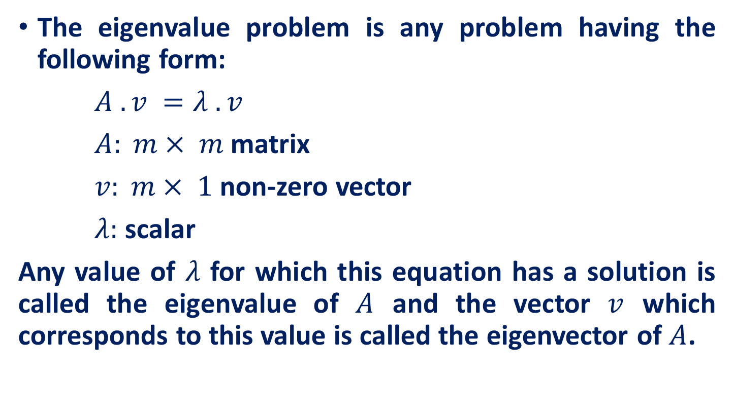
Eigenvalue Problem
The eigenvalue problem is any problem having the following form:
$A . v =λ . v$
$A: m× m$matrix
$v: m× 1$non-zero vector
$λ:$ scalar
Any value of $λ$ for which this equation has a solution is called the eigenvalue of $A$ and the vector $v$ which corresponds to this value is called the eigenvector of $A$.

Slide 5

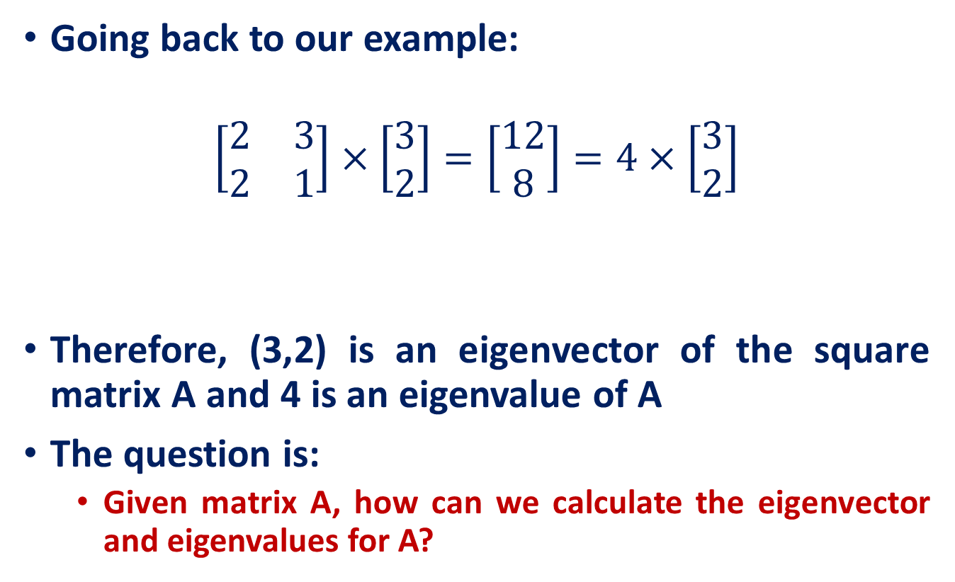


Eigenvalue Problem
Going back to our example:
$$\left[\begin{matrix}2 & 3 \\ 2 & 1\end{matrix}\right]×\left[\begin{matrix}3 \\ 2\end{matrix}\right]=\left[\begin{matrix}12 \\ 8\end{matrix}\right]=4×\left[\begin{matrix}3 \\ 2\end{matrix}\right]$$
Therefore, (3,2) is an eigenvector of the square matrix A and 4 is an eigenvalue of A
The question is:
Given matrix A, how can we calculate the eigenvector and eigenvalues for A?
A
$$×$$
v
$λ$
$$×$$
v

Slide 6
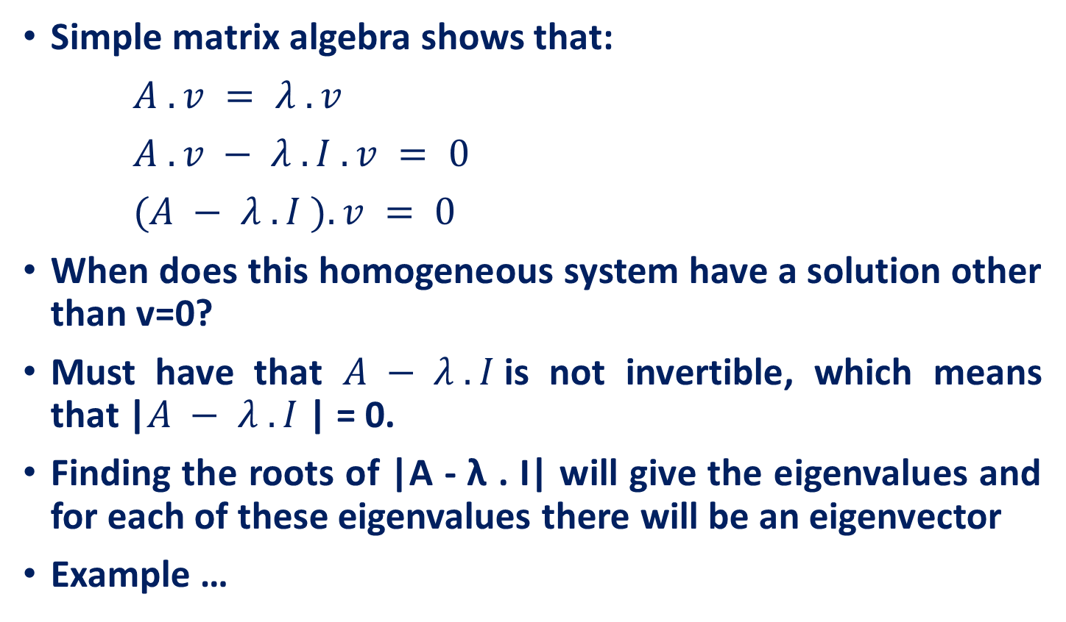
Calculating Eigenvectors & Eigenvalues
Simple matrix algebra shows that:
$A . v = λ . v$
$A . v − λ . I . v = 0$
$(A − λ . I ). v = 0$
When does this homogeneous system have a solution other than v=0?
Must have that $A − λ . I$is not invertible, which means that |$A − λ . I$| = 0.
Finding the roots of |A - λ . I| will give the eigenvalues and for each of these eigenvalues there will be an eigenvector
Example …

Slide 7
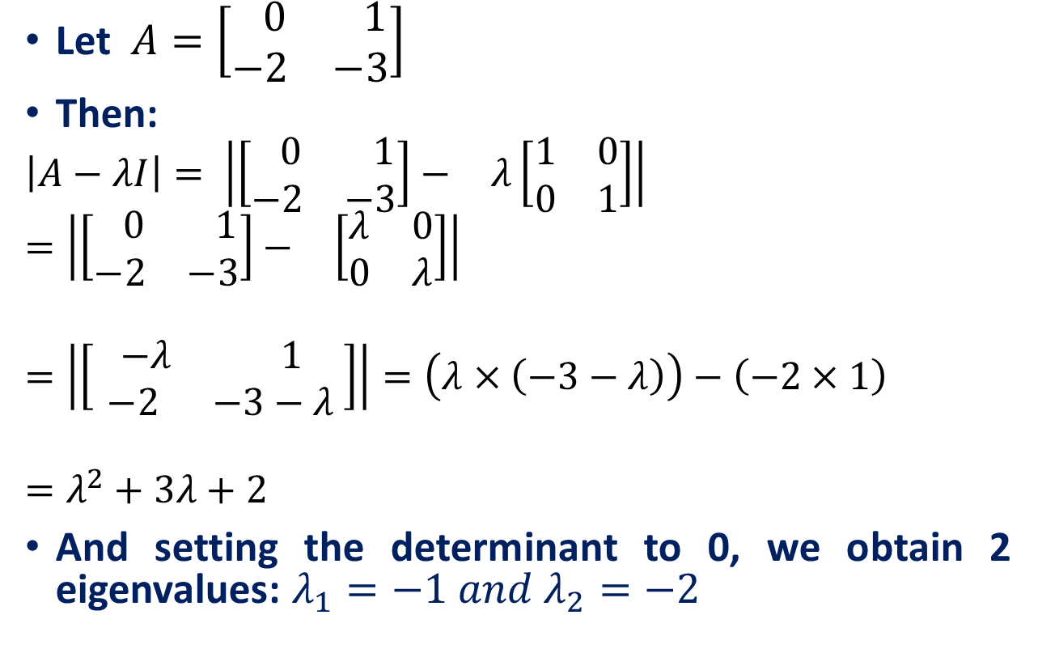
Calculating Eigenvectors & Eigenvalues
Let $A=\left[\begin{matrix} 0 & 1 \\ −2 & −3\end{matrix}\right]$
Then:
$$\left|A−λI\right|= \left|\begin{matrix}\left[\begin{matrix} 0 & 1 \\ −2 & −3\end{matrix}\right]− & λ\left[\begin{matrix}1 & 0 \\ 0 & 1\end{matrix}\right]\end{matrix}\right|=\left|\begin{matrix}\left[\begin{matrix} 0 & 1 \\ −2 & −3\end{matrix}\right]− & \left[\begin{matrix}λ & 0 \\ 0 & λ\end{matrix}\right]\end{matrix}\right|$$
$$=\left|\begin{matrix}\left[\begin{matrix} −λ & 1 \\ −2 & −3−λ \end{matrix}\right]\end{matrix}\right|=\left(λ×\left(−3−λ\right)\right)−\left(−2×1\right)$$
$$=λ^{2}+3λ+2$$
And setting the determinant to 0, we obtain 2 eigenvalues: $λ_{1}=−1 and λ_{2}=−2$

Slide 8

Calculating Eigenvectors & Eigenvalues
For $λ_{1}$the eigenvector is:
$\left(A−λ.I\right).v=0$
$\left[\begin{matrix}1 & 1 \\ −2 & −2\end{matrix}\right] \left[\begin{matrix}v_{11} \\ v_{12}\end{matrix}\right]=0$
$v_{11}+v_{12}=0$ and ${−2v}_{11}−2v_{12}=0$
$v_{11}={−v}_{12}$

Slide 9
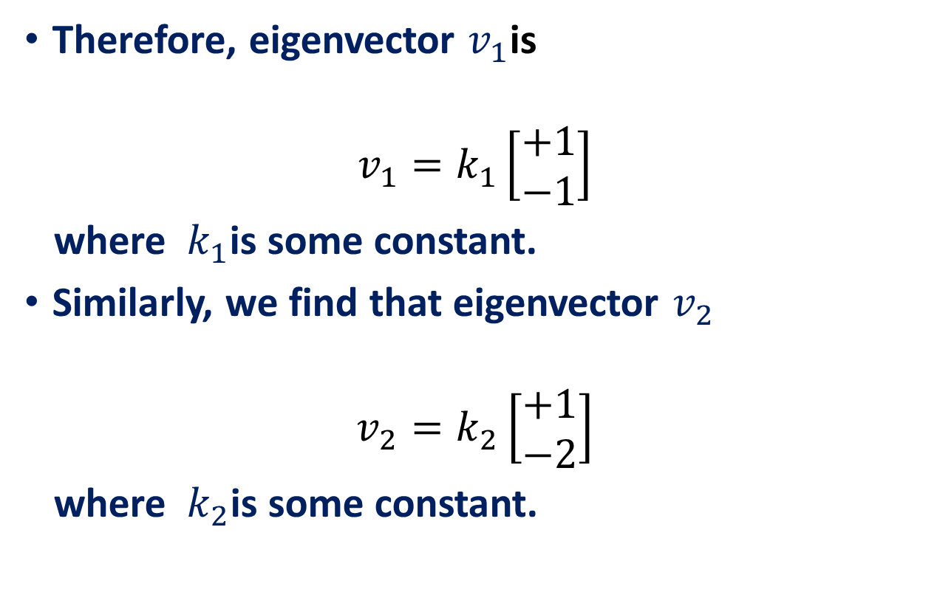
Calculating Eigenvectors & Eigenvalues
Therefore, eigenvector $v_{1}$is
$$v_{1}=k_{1}\left[\begin{matrix}+1 \\ −1\end{matrix}\right]$$
where $k_{1}$is some constant.
Similarly, we find that eigenvector $v_{2}$
$$v_{2}=k_{2}\left[\begin{matrix}+1 \\ −2\end{matrix}\right]$$
where $k_{2}$is some constant.

Slide 10
Properties of Eigenvectors and Eigenvalues
Eigenvectors can only be found for square matrices and not every square matrix has eigenvectors.
Given an m x m matrix (with eigenvectors), we can find m eigenvectors.
All eigenvectors of a symmetric matrix are perpendicular to each other, no matter how many dimensions we have.
In practice eigenvectors are normalized to have unit length.

Slide 11
Reference
Introduction to Linear Algebra, Mark Goldman, Emily Mackevicius
Lecture Notes on Linear Algebra, Arbind K Lal, Sukant Pati
Lecture notes on linear algebra, David Lerner
6502 : Mathematics for Engineers 2, James Burnett, Department of Mathematics, University College London
ENGG2013, Advanced Engineering Math. Kenneth Shum
Matrices and Determinants – 2, Carrer launcher
http://www.shsu.edu/ldg005/data/mth199/chapter5.ppt

